Slide 1
Introduction to Simulation and Modeling
Azaz Ahmed Kiani

Slide 2
Validation
(Lecture 21,22)

Slide 3
Face validity
Face validity is normally achieved with the assistance of domain experts.
Most practitioners attempt to achieve face validity toward the end of the allocated model development period.
This allows the practitioner to make minor adjustments to the model before beginning the statistical validity process.
Unfortunately, the face validity process is usually considered a one-time event instead the practitioner should consider face validity as a continuous process.

Slide 4
Face validity
In order to execute properly the face validity process, the practitioner must insure that the animation of the process has sufficient visual fidelity to the actual process.
Sometimes domain experts will want to know how the model handles unusual events. This might involve:
  • Breakdowns of critical pieces of machinery or vehicles
  • Arrival of large numbers of customers in buses
  • Late flights of air passengers seeking rescheduling help at a service counter
To allow the practitioner to demonstrate these effects, most simulation packages allow the programming of hot keys to initiate these types of unusual events.

Slide 5
Face validity
Face validity is considered necessary but alone is insufficient for determining overall model validity.
To establish complete model validity, statistical validation analysis must also be conducted.

Slide 6
Statistical validity
Statistical validity involves an objective and quantitative comparison between the actual system and the simulation model.
If there is no statistically significant difference between the data sets, then the model is considered valid.
Conversely, if there is a statistically significant difference, then the model is not valid and needs additional work before further analysis may be conducted.

Slide 7
Validation data collection
Validation data collection involves collecting data from both the actual system and the base simulation model that is designed to represent the actual system.
Validation data may be based on either individual
Observations
  practitioner will perform the analysis using data from individual entity measures of performance.
or
Summary statistics.
  the summary statistic approach involves analysis using mean data from multiple sets of observations of individual entity measures of performance.

Slide 8
Individual Entity Validation Data Approach
Individual entity validation data involve the collection of system times for individual entities going through the system and through the model.
Depending on the exact system, this type of data could be collected in a number of hours or days.

Slide 9
Entire System and Model Run Validation Data Approach
The second approach is to use a number of entire system and model run data.
This approach requires a significantly greater amount of actual system data collection than the individual entity approach.
Here, we would pick a particular time period and collect all of the order-processing times observed during the time period.
An average for all of the orders for that time period would be calculated.

Slide 10
Validation Data Analysis Process
(Lecture 21,22)

Slide 11
Hypothesis Tests
If both the system and the model validation data sets are found to be normal, we next need to establish if the system and model data are statistically similar with a hypothesis test.
Hypothesis tests involve the establishment of a null hypothesis that the means of the data sets are statistically similar.
The null hypothesis, in practitioner terms, is either accepted or rejected.
If it is accepted, then the simulation model is valid. If it is rejected, then the model is invalid.
In this case, additional model development will be necessary.

Slide 12
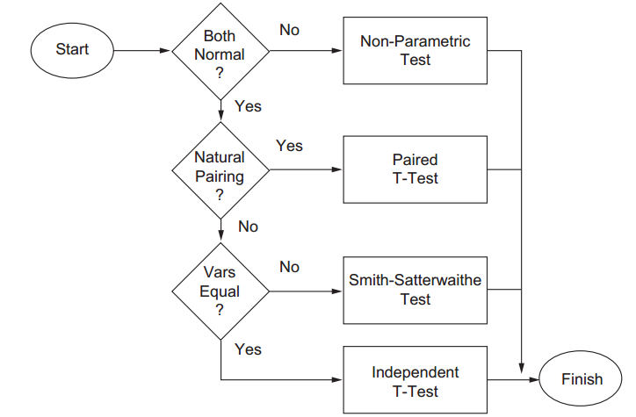
Hypothesis Tests

Slide 13
F-Test
The F-test compares the variance of the system validation data set and that of the model validation data set.
In this version the practitioner is interested in calculating a test statistic of the ratio of the larger variance divided by the smaller variance.
It does not matter whether the larger or the smaller variance is from the system validation data set or the model validation set.
This test statistic is compared to a critical F-value at a particular level of statistical significance.
A common level of statistical significance is α= 0.05.

Slide 14
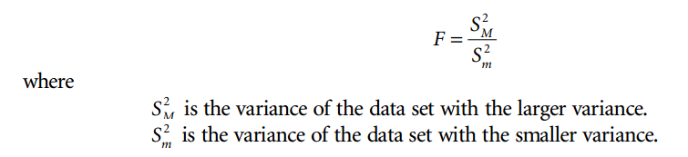
F-Test

Slide 15
F-Test
The steps involved in implementing the F-test are:
1. Null hypothesis: variances of both groups are equal.
2. Alternative hypothesis: variances of both groups are not equal.
3. Select a level of significance.
4. Determine the critical value for fat the level of significance divided by 2 with degrees of freedom according to the number of samples in the data set with the larger variance: 1 for the numerator and number of samples in the data set with the smaller variance; 1 for the denominator.
5. Calculate the test statistic f according to the formula above.
6. Reject the null hypothesis if the test statistic exceeds the critical value.

Slide 16
Example of the F-Test

Slide 17
The following data sets were obtained from two different simulation models of our airport security checkpoint system.
Alternative A is a model of the system with two ticket checkers, two metal detectors, and two x-ray machines.
Alternative B is an alternative model: the same system with three ticket checkers, two x-ray machines, and one metal detector.
The mean time in minutes for being processed through the system for 40 actual system passengers and 40 model passengers is listed in the following table:

Slide 18
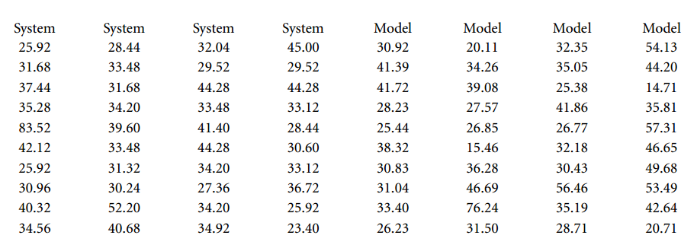

Slide 19
The variance of the system is 99.36 s, and the variance of the model is 152.96 s.
With this summary statistical information, we are ready to begin our F-test calculations.
Ho The variance of alternative A is equal to the variance of alternative B;
Ha : the variance of alternative A is not equal to the variance of alternative B.
We select a 0.90 level of significance or 0.10 as an α level.
The critical value for F at α/2 with 39 degrees of freedom in both the numerator and denominator is 1.70.
The F statistic is calculated by:

Slide 20
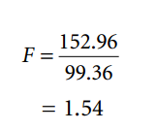
The test statistic 1.54 is less than the critical value of 1.70, so we cannot reject the null hypothesis that the data have similar variance.

Slide 21
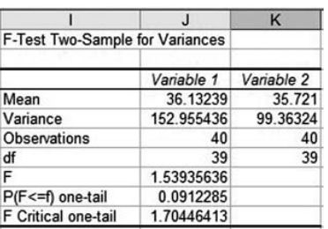

Slide 22
Independent t-Test
The independent t-test is utilized when the data are normal and the data sets have similar variance.
This test will determine if there is a statistically significant difference between two simulation models at a given level of significance.
In order to perform this test, we have to calculate the mean and sample standard deviation of both of our sets of data.
The procedure is as follows:

Slide 23
Independent t-Test
Null hypothesis: means of both groups are equal.
Alternative hypothesis: means of both groups are not equal.
Select a level of significance.
Determine the critical value for tat the level of significance divided by 2 with degrees of freedom according to number of samples in both the datasets minus 2.
Calculate the test statistic t according to the formula above.
Reject the null hypothesis if the test statistic is either greater than the critical value or less than the negative of the critical value.

Slide 24
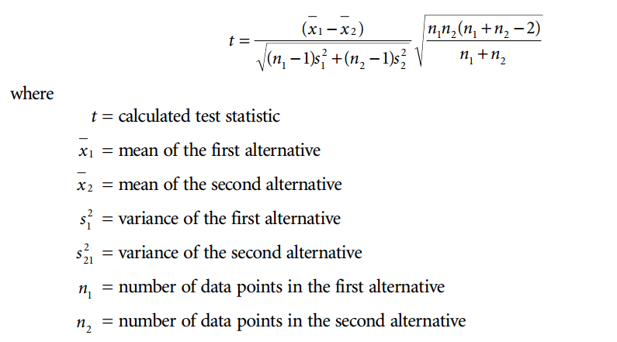
Independent t-Test
The formula for calculating the test statistic t is:

Slide 25
Example of the T-Test

Slide 26
If we assume that the data sets from the previous example are both normal, we could perform an independent t-test to determine if a difference exists between the two data sets.
The mean and standard deviation for the system, in seconds, are 35.72 and 9.97, respectively.
The mean and standard deviation for the model, in seconds, are 36.13 and 12.37.
Ho : The mean of alternative 1 is equal to the mean of alternative 2.
Ha : The mean of alternative 1 is not equal to the mean of alternative 2.
Use a level of significance α= 0.05.
The critical value for tat α/2, 78 degrees of freedom, is 1.991.
The test statistic is:

Slide 27
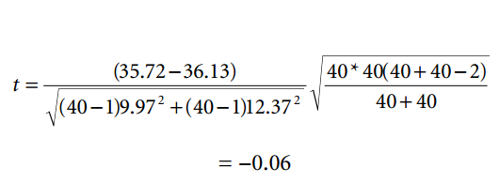
The test statistic t of −0.06 is between −1.991 and 1.991, so we cannot reject the null hypothesis.
This means that there is no statistically significant difference between the actual system and the simulation model.

Slide 28
Smith–Satterthwaite Test Implementation
In the event that the system and model data are both normal but the variances are dissimilar, the practitioner can utilize the Smith–Satterthwaite test to validate the simulation model.
As with the small sample t-test, the practitioner must reutilize the previously collected mean and standard deviation of both the system and model validation data.
The Smith–Satterthwaite test accounts for the differences in variance by adjusting the degrees of freedom for the t critical value.
The degrees of freedom estimator uses the formula below:

Slide 29
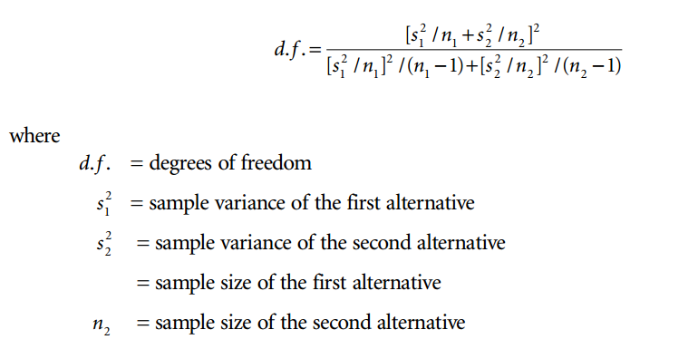
Smith–Satterthwaite Test Implementation

Slide 30
Smith–Satterthwaite Test Implementation
In most cases the number of degrees of freedom calculated in this manner will not be an integer.
The natural question again becomes whether to round up or round down. In general, as a practitioner, you want to take the most conservative approach.
This means that under questionable circumstances you would rather reject the null hypothesis and conclude that the model is invalid than you would want to accept the null hypotheses and conclude that the model is valid.
This means that we want a smaller rather than larger critical value. Because the t value increases as the number of degrees of freedom decreases, we want to round the estimated degrees of freedom upward.

Slide 31
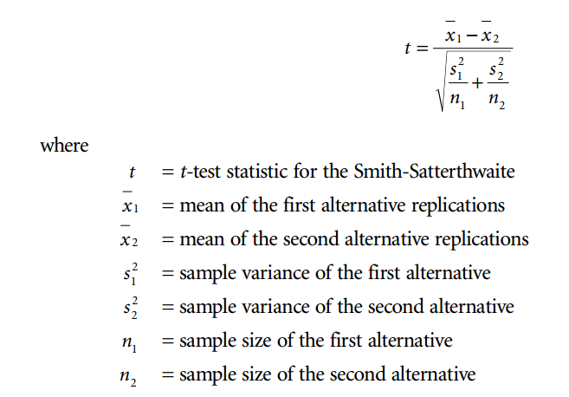
Smith–Satterthwaite Test Implementation
Once the degree of freedom estimator has been calculated, the practitioner can use the following formula to calculate the Smith–Satterthwaite test statistic

Slide 32
Smith–Satterthwaite Test Implementation
(Example)

Slide 33
Assuming that our system and model data set actually rejected the F-test null hypotheses, we would have needed to utilize the Smith–Satterthwaite hypothesis test.
Using the same mean and standard deviation values for the system and model data, our process is:
Ho: The mean of the system is equal to the mean of the model; i.e., our model is valid.
Ha : The mean of the system is not equal to the mean of the model; i.e., our model is not valid.
Level of significance is 0.05.
The critical value is calculated with:

Slide 34
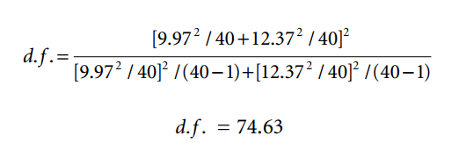
Degree of Freedom (SS Test)

Slide 35
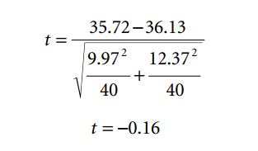
SS Test
As we discussed, the practitioner is interested in being conservative, so we round up to the nearest degree of freedom to 75.
The critical value with α= 0.05 and 75 degrees of freedom is 1.992.
The test statistic is:

Slide 36
SS Test
Because –0.16 is between –1.991 and 1.991, we cannot reject the null hypothesis that the means of the system and model are the same.
This means that the model is valid.

Slide 37
Nonparametric Test Implementation
A nonparametric test is utilized when either one or both of the validation data sets is non-normal.
An easily implemented nonparametric test is the Utest or rank sum test.
This test compares the sum of the ranks of the data points from each of the validation data groups.
To implement the rank sum test, the practitioner sorts the data from each group in ascending order.
After sorting, the practitioner merges the data sets together while maintaining the identity of the set the data originally came from.

Slide 38
Nonparametric Test Implementation
In a spreadsheet application, the first column would correspond to the data while the second column would correspond to the data set.
Typically, column 1 would represent the system validation data, while column 2 would represent the model data.
A third column is used to rank all of the observations. Because the data were sorted and merged in ascending order, the first observation will have a rank of 1, and the last observation will have a rank corresponding to the total number of data points in both groups.
The rank positions from group 1, the system data, are summed as variable W1. Similarly, the rank positions from group 2, the model data, are summed as variable W2.

Slide 39
Nonparametric Test Implementation
In theory, if the model is valid, the sorted data will be approximately evenly interlaced between the system and the model validation data, and W1 and W2 will be close in value.
Conversely, if the model is not valid, then the system and model data will not be approximately evenly distributed.
This means that either W1 or W2 will be significantly smaller than the other.
To determine whether the difference is statistically significant, a few additional calculations must be conducted.

Slide 40
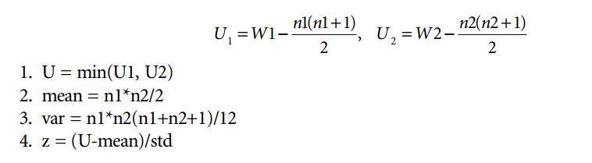
Nonparametric Test Implementation

Slide 41
Nonparametric Test Implementation
In step 2, we retain the smaller of the two values, U1 and U2. In step 3, we are calculating the average value for all of the ranks.
In step 4 we have the variance of all of the rank values.
In step 5 we have the equivalent of a Ztest statistic that can be used for a hypothesis test in the same manner as in the previous examples.

Slide 42
Nonparametric Test
(Example)

Slide 43
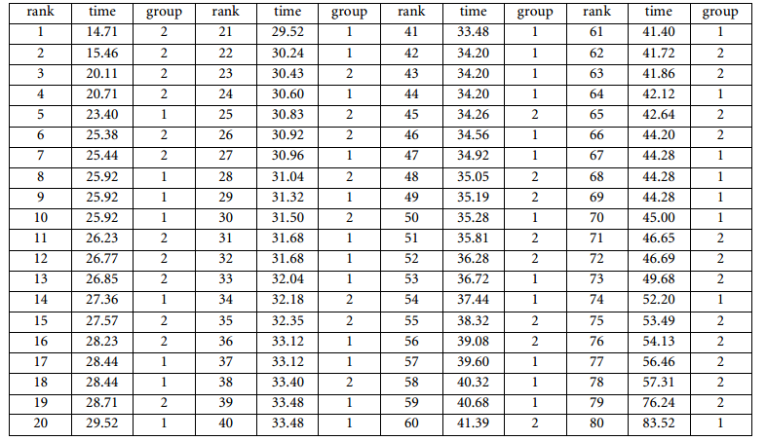
Nonparametric Test Implementation

Slide 44
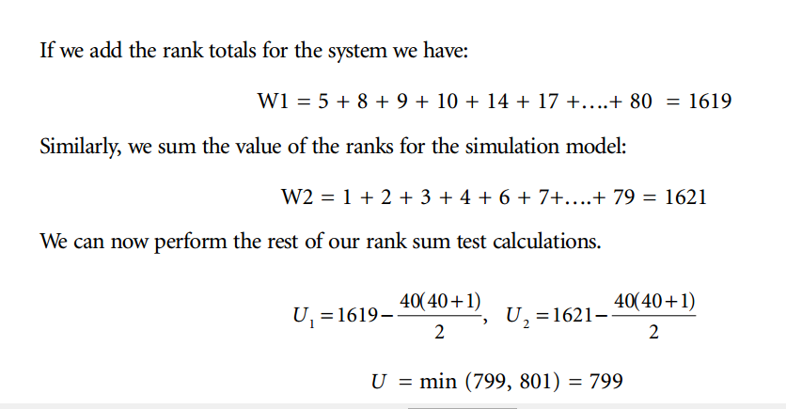
Nonparametric Test Implementation

Slide 45
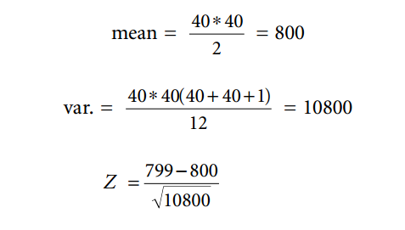
Nonparametric Test Implementation

Slide 46
Nonparametric Test Implementation
The Z-value is plus or minus 1.96. Because –0.0096 is between –1.96 and 1.96
we cannot reject the null hypothesis that the two data groups are statistically similar.
This means that the model is valid.

Slide 47
Summary
Any Questions?

